Slide 1






KEY STAGE 2 SATS MEETING
2025 - 26

Slide 2





WHY DO CHILDREN IN YEAR 6 TAKE THE SATS TESTS?
These tests, alongside teacher assessment of English writing and Science, are used to measure school performance. The assessments are also used to help inform children’s transition to secondary school to ensure pupils have the support that they need. Some secondary schools will use the scores to set Year 7 pupils whereas others may use internal data.

Slide 3








When?
Monday 11th May | Tuesday 12th May | Wednesday 13th May | Thursday 14th May
Grammar and Punctuation 45 minutes Spelling - 20 minutes | Reading 1 hour | Arithmetic 30 minutes Maths paper 2 40 minutes | Maths paper 3 40 minutes
What do they look like?

Slide 4




What will SATs week look like in school?
The children will have quiet spaces to complete their learning. This might be in the classroom, in the hall or in a smaller space around the school.
There will be plenty of adults to offer emotional support during the tests.
Some children will use a reader, a scribe or have additional time. This reflects classroom practice e.g. if your child has some of their learning scribed for them during lesson, this will also happen during the tests.
The children will have time to decompress after the papers and will still have playtime. The rest the day will then run as usual.

Slide 5


HOW ARE THE TESTS MARKED, AND WHAT DO THE SCORES MEAN?
PAPERS ARE NOT MARKED BY THE SCHOOL
At Key Stage 2, the SATs papers are marked externally.
The mark your child gets in each test is called the raw score. This raw score for each test will be translated into a scaled score, which will show how well your child has done against the expected standard.
Children who achieve a scaled score of 100 meet the expected standard. Above 100 means they are exceeding the expected standard; below 100 means they are still working towards it.
You will receive your child’s raw score and scaled score for each test, as well as confirmation of whether or not they have achieved the expected standard. This will be in July with their school report.

Slide 6


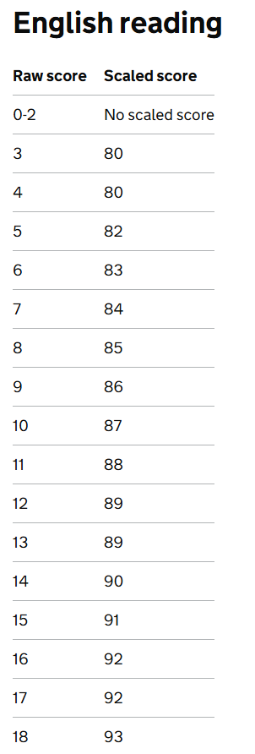
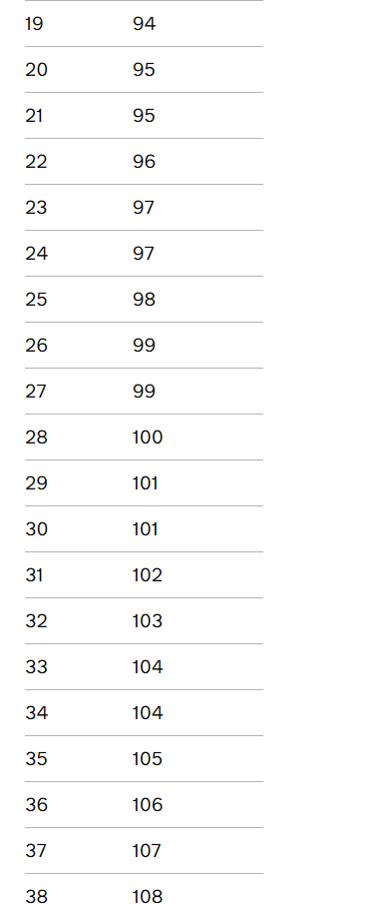




2025 scaled scores

Slide 7







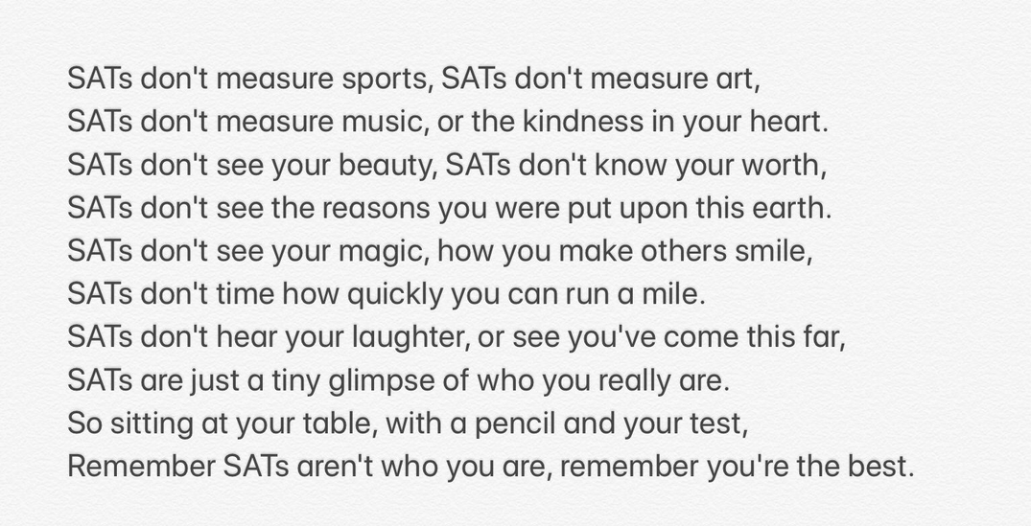
weekly home learning
in class we practise arithmetic questions daily.
at home, complete the weekly arithmetic and bring it back to school so that we can mark them together.
Arriving on time each morning.
We start our spelling lesson at 8:50 so it is important to be on time and ready for learning.
How best can we support the children?
  at home and at school
Encouragement and reassurance
Reading stamina
The reading paper is lengthy and we are developing our reading stamina. Practicing this at home as well as at school will help our stamina to build.

