Slide 1

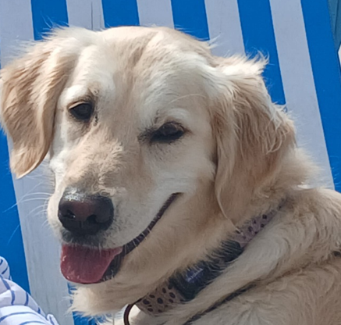
Lottie’s Rules
4 Paws on the Floor I am learning to stay calm.
Please don’t touch me if I’m jumping or trying to climb.
Soft sensible stroking
I am learning to enjoy being touched.
Please be gentle and avoid my eyes, mouth and bottom.
Be a tree
I am learning to be calm when I’m around you.
If I get too excited stand up, fold your arms and be a tree to help me calm down.
Mind my mouth
I am learning to explore the world without using my mouth. Please don’t put your hands near my mouth or let me nibble your clothes.

