Slide 1
Welcome to Year 5
Thanks for coming today!

Slide 2
Expectations for the year ahead:
Reading – 20 minutes, at least 3 times a week. The more reading and the wider reading, the better.
Home learning:
  Tasks on PurpleMash every Wednesday which are linked to our class learning (usually)
  TTRockstars. They all did very well in their MTC but the faster they are, the easier they will find maths in general!
Uniform – named, please!
Coats – Every day.

Slide 3
PE:
Term 1 and 2 Friday afternoons
Children should wear their weather appropriate kits into school on that day. There is no need for a change of clothes.
Term 3 and 4 will see us head back to swimming on a Wednesday afternoon.
For the first two terms, we will be outdoors so warm clothes as the year moves on will be useful.

Slide 4
Trips for the year
Term 1 – Earth and Beyond – Betteshanger – Outdoor Adventurous Activities
Term 2 – Crime and Punishment – TBD!
Term 3 – The Groovy Greeks – The Olympics at Priory Fields
Term 4 – Foritfy and Defend – Dover Castle – Learning Launch and Landing (with parents)
Term 5 – Riveting Rivers – Kearsney Abbey
Term 6 – Codebreakers - TBD

Slide 5

Term 1 Learning Landing – Out of This World Art Gallery
You are invited to join us for art, snacks and drinks on 20th October 2025!
Probably 2 – 3pm

Slide 6
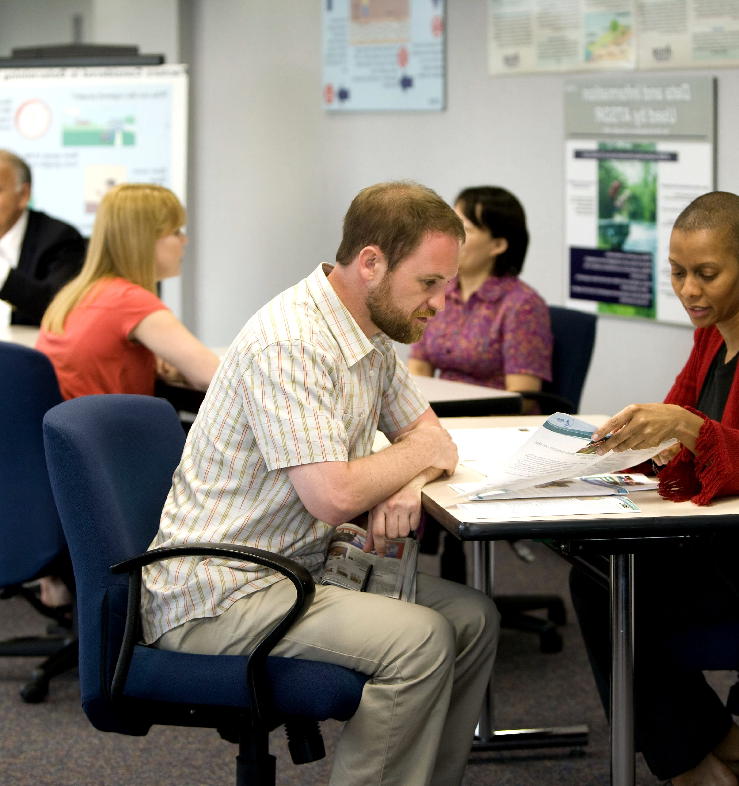
Dates of Parent meetings and
Drop-ins Consultation
11th / 12th November 2026
10th / 11th March 2027
7th July 2027

Slide 7
Contact us:
At the gate every afternoon or morning if needed
On the phone via the office
vvyear5@vale-view.kent.sch.uk

Slide 8
Things you will need to do before the end of year 5:
Decision about the Kent Test

