Slide 1
















Year 6 welcome meeting
vvyear6@vale-view.kent.sch.uk

Slide 2



What will we be learning about?
Our topics will be:
Fit for life
World War I
Ancient Maya
World War II (term 4 and 5)
Evolution and adaption

Slide 3
What will we be learning about?
Our trips will be:
Residential trip - term 1
WWI trench experience - term 2
War memorial - term 2
Botany Bay - term 6
Science Jamboree - term 6

Slide 4
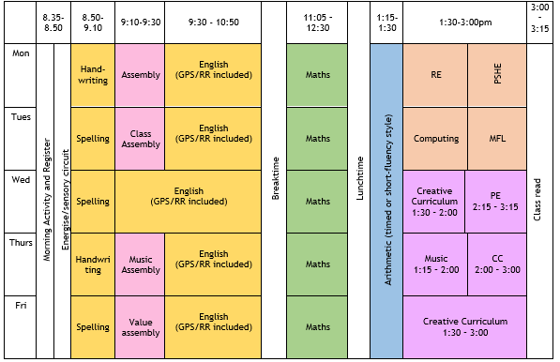
Why is punctuality important in Year 6?
During these early morning sessions, interventions will also take place.

Slide 5





Reading at home
Children are encouraged to read at least 3 times a week and their reading records are checked to see if an adult at home has counter-signed. When an adult in school listens to a child read, their reading record will be stamped so parents can see when their child has been heard.

Slide 6




Home Learning
Children will be assigned 2 tasks each week to complete on Purple Mash. These will be assigned on Mondays. Feedback will be given on Purple Mash.
Children will be expected to complete 20 minutes on TTRS each week.
Weekly spellings: Weekly spellings will be sent home in your child’s reading record. They should learn these at home ready to use them in the classroom.
All logins can be found in your child’s reading record

Slide 7
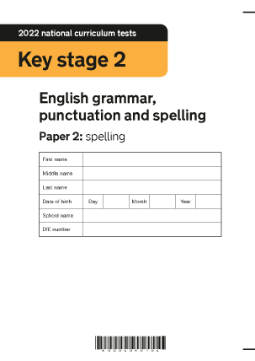
KS2 statutory assessments (SATS)
The statutory key stage 2 tests are timetabled from Monday 10th May to Thursday 13th May 2027.
-Grammar and punctuation;
-Spelling;
-Reading;
-3 maths papers.
Children will also be assessed on their independent writing from January.

Slide 8











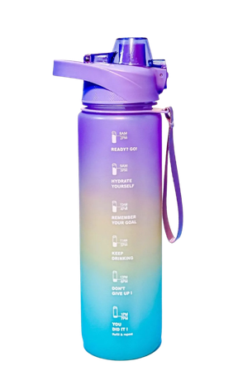

PE will take place each Wednesdays afternoon.
This term, we will developing skills in athletics. Trainers will be needed.
Children should only bring a phone into school if they are walking to/from school alone. All phones must be handed in at the start of the day.
Other reminders
Children should bring their water bottles into the classroom each day
Pencil cases are not required in Year 6. This is in an effort to promote good presentation and prevent any items going missing.
Please inform the class team if your child is allowed to walk home alone. This could be via email or a call to the office.

Slide 9
Key Dates
Dates for your diary:
21st September at 3:00pm - residential trip meeting
14th October 2026 to Friday 16 October 2026 - Residential trip
22nd October at 2:30pm - Year 6 wellness cafe (learning landing)
W/b 10th November - Parent consultation evenings
20th November - Year 6 trip to WWI trench experience in Elham (details to follow)

Slide 10
Any questions?
Year 6 Request - Donations of wet play games
Any board games, card games, puzzles, Lego etc. would be greatly appreciated.

